Slide 1

LINKED LIST
UNIT II

Slide 2
SYLLABUS
Introduction
Single linked list
Representation of a linked list in memory
Operations on a singly linked list
Merging two singly linked lists into one list
Reversing a singly linked list
Applications of singly linked list to represent polynomial expressions and sparse matrix manipulation
Advantages and disadvantages of singly linked list
Circular linked list
Doubly linked list
Circular Doubly Linked List.

Slide 3

Introduction
A Linked list is a data structure in which the elements or objects are organised in a linear order.
Data is organized in a non-contiguous manner
Data can be heterogenous

Slide 4

Example
The list of alphabets as a linked list.
Data part consists of the alphabet and the pointer leads to the next alphabet

Slide 5
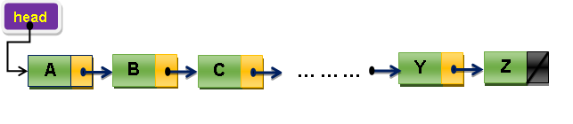
Head Node

Slide 6
Types of Linked List
Singly or Simple Linked List – Link Part of Last node points to NULL.
Circular Linked List – Link Part of Last Node points to the first node (otherwise the pointer head reference to).
Doubly Linked List – Has two Link Parts named as forward link and backward link. First node’s backward link and Last Node’s forward link is set to NULL.
Circular Doubly Linked List– Combination of Circular and Doubly Linked List.

Slide 7
Why Linked List?
Applications that are required to maintain the Most Recently Used List (as in a file menu). Linked list of file names.
Cache in the browser. When the back button is selected, the previously visited url’s is to be redirected. Linked list of url’s.
Undo option in a Word Processor. Linked List of previous state.
To represent a deck of cards. Linked List of cards.
A set of objects that are to be rendered in a 3D gaming environment.
To represent polynomials of the form: ax^{n} + ax^{n-1} + … + ax¹ + 1.
In operating systems, for handling dynamic memory management for allocation and release of memory at the time of execution.
To implement and represent the linear / non-linear data structures like stack, queues, trees and graphs.

Slide 8
ADT of Linked List
struct node {
/* data members */
/* data part */
<data type>element;
/* link part */
/* sufficient for singly and circular linked list */
struct node *next;
/* required for doubly and circular doubly linked list */
struct node *prev;
}

Slide 9
ADT Operations…
int size();
int isEmpty();
void create();
void destroy();
void add(element);
void remove(element);
void traverse();
void search(element);

Slide 10
Single Linked List
A singly linked list is a list of items ordered sequentially with exactly one pointer on every node.
Only forward traverse is possible in this type of linked list.
The last node link pointer is always set to null.
Eg. Representation of Alphabets

Slide 11
Structure
struct node {
/* to store the alphabets as the data part */
char alpha;
/* points to the next element in the list */
struct node *next;
};

Slide 12
Initialize the head node
struct node *head = NULL;
Memory allocation for a new node:
struct node *newnode =
(struct node *) malloc (sizeof(struct node));

Slide 13
Inserting the First Node (Case 1)
If (head == NULL) {
/* address of the newly created node is referenced by the head node */
head = newnode;
/* alphabet ‘A’ is added to the list */
/* link part of the node is set to null */
newnode->alpha = data;
newnode->next = NULL;
}

Slide 14
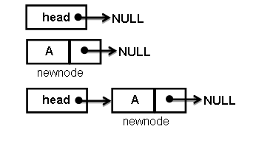
Insertion…

Slide 15
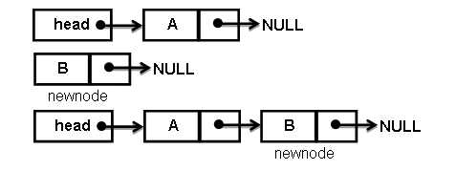
Insertion (Case 2)
struct node *start = head;
If (head != NULL) {
while (start->next != NULL)
start = start->next;
start->next = newnode;
newnode->data = data;
newnode->next = NULL;
}

Slide 16
Traverse the List
while (start->next != NULL) {
printf(“\nData = %c”, start->alpha);
start = start->next;
}

Slide 17
Remove an Element
struct node *start = head;
struct node *prev = NULL;
while (start != NULL){
if (d==start->alpha){
if (start == head)
head = start->next;
else
prev->next = start->next;
return start->alpha;
}
else {
prev = start;
start = start->next;
}
}

Slide 18
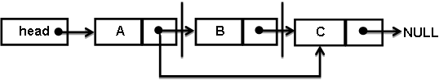
Deletion – Node with Data Part – “B”

Slide 19
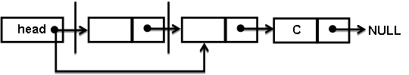
Delete the Head Node

Slide 20
Search
struct node *start = head;
if (start == NULL)
return 0;
while (start != NULL) {
if (start->alpha == d)
return d;
else
start = start->next;
}

Slide 21
Assignment
insert_at_beg
insert_before
insert_after
delete_front
delete_before
delete_after
delete_end
is_empty
First
Last
size

Slide 22
Circular Linked List
Circular Linked List is an extension to the Singly Linked List, in which the last node’s link part points to the first node.
In some applications the data may be viewed in a cyclic order in which there is no fixed first element or the last one.
For e.g.,
round robin process scheduling in an operating system,
implementation of Fibonacci heap,
in multi-player game (where one player gets the turn after all the players completed their chance),
escalator.

Slide 23
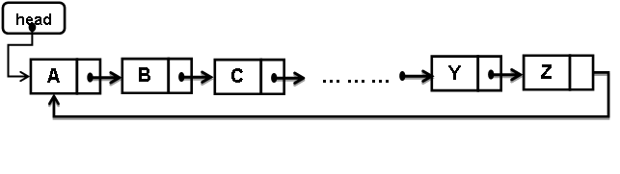
Example

Slide 24
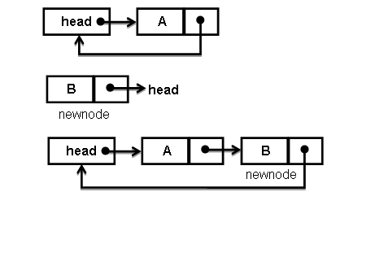
Insertion
newnode->next = head;

Slide 25
Doubly Linked List
Doubly linked list is a special case of singly linked list, an additional link part included for effective traverse.
The list is capable of navigating in both forward and reverse directions.
Reduce in time complexity for the insertion and deletion operations.
Applications of doubly linked list:
implementation of non-linear data structures like trees, graphs,
arrangement of deck of playing cards,
maintain the urls in browser (back and forward actions),
thread scheduler in operating systems …

Slide 26
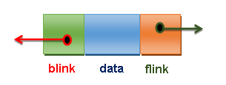
Structure
struct dllnode {
<data type> member_variable;
struct dllnode *flink;
struct dllnode *blink;
};

Slide 27
Example
head
A
B
C

Slide 28
Insertion Procedure
/* set the backward link of new node as the previous node */
newnode->blink = prev;
/* set the forward link of the new node as the previous nodes forward link */
newnode->flink = prev->flink;
/* the reverse link of the forward node from new node is set as the new node */
prev->flink->blink = newnode;
/* forward link of the previous node is set to new node */
prev->flink = newnode;

Slide 29
Insert a New Node
struct node *newnode = (struct node *) malloc(sizeof(struct node));
struct node *start = head;
struct node *prev = NULL;
while (start->flink != NULL ) {
if (start->alpha == after){
newnode->alpha = data;
newnode->blink = prev;
newnode->flink = prev->flink;
prev->flink->blink = newnode;
prev->flink = newnode;
return 0;
} else {
prev = start;
start = start->flink;
}
}

Slide 30
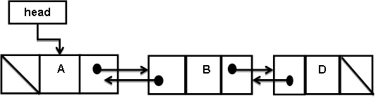
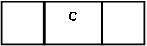
Example

Slide 31
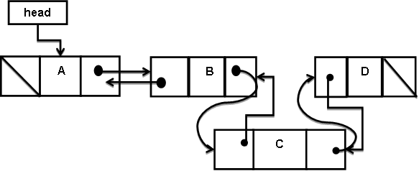
Insertion Procedure

Slide 32
Deletion Procedure
while (start != NULL) {
if (data == start->alpha) {
if (start == head) {
head = start->flink;
start->flink->blink = NULL; }
else{
prev->flink = start->flink;
prev->flink->blink = prev; }
return start->alpha; }
else {
prev = start;
start = start->flink;
} }

Slide 33
Circular Doubly Linked List
Circular doubly linked list forms a cyclic representation in which the first node’s reverse link points to the last node and the last node’s forward link points to the first node.
Since the first node and last node are reachable, the complexity becomes less while performing the fundamental operations.

Slide 34
Example
head
A
B
C

Slide 35
Complex Operations
Operations like
reversing a linked list,
merging two or more lists (sorted or unsorted) or
sorting a list or
inserting a new node into a sorted list
are some of the complex functions applied on the linked lists other than the fundamental manipulations.

Slide 36
Reverse a Linked List
Iterative
Recursive
10
20
30
40
50
50
40
30
20
10

Slide 37
Iterative Approach
The procedure for reversing a linked list by iterative method starts from the head pointer as in other operations.
Steps involved in this process are:
Set the link pointer of the first node to NULL,
Second node’s link points to the first node,
Third node points to the second node and so on.
Finally, head should point to the last node.

Slide 38
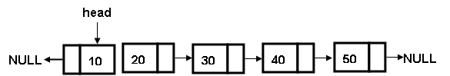
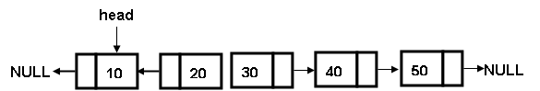
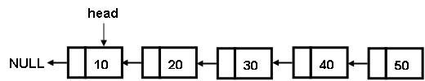

Example

Slide 39
Code Snippet
head = 00530D18 (Address of the first node)
struct node *current = head;
struct node *prev = NULL;
struct node *next = NULL;
while (current != NULL) {
next = current->next;
current->next = prev;
prev = current;
current = next;
}
head = prev;
Data | Node Address | Next Pointer
10 | 00540D18 | 00540D38
20 | 00540D38 | 00540D48
30 | 00540D48 | 00540D58
40 | 00540D58 | 00540D68
50 | 00540D68 | NULL
Data | Current Address | Previous Address | Next Address
10 | 00000000 | 00000000 | 0028FFCC
20 | 00530D38 | 00530D18 | 00530D38
30 | 00530D48 | 00530D38 | 00530D48
40 | 00530D58 | 00530D48 | 00530D58
50 | 00530D68 | 00530D58 | 00530D68
head = 00530D68
Data | Node Address | Next Pointer
50 | 00530D68 | 00530D58
40 | 00530D58 | 00530D48
30 | 00530D48 | 00530D38
20 | 00530D38 | 00530D18
10 | 00530D18 | NULL

Slide 40
Recursive Procedure
Step 1: Using recursion, traverse the list till the end of the list.
Step 2: Set the last node as the head node.
Step 3: Currently, the pointer is in the last node.
All the remaining elements are stored in the stack.
Step 4: Traversing back, the elements are popped out from the stack in the reverse order.
Create the link that points to the next element that pops out from the stack.

Slide 41
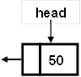
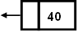
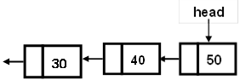
Code Snippet
struct node recursiveReverse(struct node *current) {
/* current is set to head in the first iteration */
if (current == NULL)
return NULL;
if (current->next == NULL) {
head = current;
return NULL;
}
recursiveReverse(current->next);
current->next->next = current;
current->next = NULL;
return head;
}
40
30
20
10
Stack
Pop->40
30
20
10
Stack
Pop->30
20
10
Stack

Slide 42
Merging of Two Lists
void mergeList(struct node *p1,struct node *p2) {
/* p1 – points to the head of the first list. p2 – points to the head of the second list */
while(p1!=NULL && p2!=NULL) {
if(p1->data< p2->data) {
/* Comparing the data in list1 and list2. Based on the relation the element is added to the new list */
add(p1->data);
p1=p1->next; }
else if(p2->alpha < p1->alpha) {
add(p2->alpha);
p2=p2->next; }
else if(p1->alpha==p2->alpha) {
/* Elimination of duplicate entries. Adding unique entry into the new list */
add(p1->alpha);
p1=p1->next;
p2=p2->next;
} }
/*When the second list is completed and the elements in the first list are left with. . Iterate till all the remaining elements are appended.*/
while(p1!=NULL) {
add(p1->alpha);
p1=p1->next;
}
/*If the number of elements in the second list is morethan the first list, then append them. Iterate till all the remaining elements are appended.*/
while(p2!=NULL)
{
add(p2->alpha);
p2=p2->next;
}
}

Slide 43
Polynomial Expressions
Polynomial is the representation of sum of coefficient and exponents. A polynomial is expressed as:
f(x) = 10x³ + 12x² - 11x¹ + 1x⁰
The coefficients are 10, 12, 11 and 1 and the exponents are 3, 2, 1 and 0.
struct polynomial {
int coefficient;
int exponent;
struct polynomial *next;
}

Slide 44
Example
10
3
12
2
-11
1
1
0
Polynomial representation for f(x) = 10x³ + 12x² - 11x¹ + 1x⁰
The operations performed on a polynomial expression are addition, subtraction, multiplication and division.
Operation in a polynomial equation depends on the exponent.
To perform addition the exponents should match.

Slide 45
Polynomial Addition
a(x) = |  | 10x⁴ | +11x³ | +9x² | +0x | +2
b(x) = | 14x⁵ |  | -11x³ |  | +2x | +3
sum(x) = | 14x⁵ | +10x⁴ | +0x³ | +9x² | +2x | +5

Slide 46
Polynomial Multiplication
a(x) = |  | +9x² | +x | +1
b(x) = |  |  | 2x | +2
Multiply by 2x | 18x³ | +2x² | +2x
Multiply by 2 |  | +18x² | +2x | +2
multiply(x) = | 18x³ | +20x² | +4x | +2

Slide 47
Polynomial Addition Pseudocode
If polynomial_a->exp = polynomial_b->exp then
Add the coefficients and exponent of polynomial_a and polynomial_b to the result
Advance the link pointer of polynomial_a and polynomial_b to the next item in the list.
If polynomial_a->exp > polynomial_b->exp then
Add the coefficient and exponent of polynomial_a to the result
Advance the link pointer of polynomial_a to the next item in the list.
else
Add the coefficient and exponent of polynomial_b to the result
Advance the link pointer of polynomial_b to the next item in the list.
At the end of above process, there are some elements may not have been processed in both the polynomials, so that all the elements are appended to the resulting polynomial.

Slide 48
Code Snippet
struct poly *add_two_polynomials(struct poly *p1,
struct poly *p2){
struct poly *t1, *t2, *p3 = NULL;
t1=p1;
t2=p2;
while ((t1 != NULL) && (t2!= NULL)) {
/* Process all the elements in the polynomials */
if(t1->exp > t2->exp) {
/* exponent comparison of polynomial 1 and 2 */
/* add polynomial 1 to the result set */
p3 = add(p3, t1->coeff, t1->exp);
t1 = t1->next; }
else if(t1->exp < t2->exp) {
/* add polynomial 2 to the result set */
p3 = add(p3, t2->coeff, t2->exp);
t2 = t2->next;
}
else { /* exponents of both the polynomials are equal. Add the coefficients. */
p3 = add(p3, t1->coeff+t2->coeff, t1->exp);
t1 = t1->next;
t2 = t2->next;
} }
while (t1 != NULL) {
p3 = add(p3, t1->coeff, t1->exp);
t1 = t1->next;
}
/* Add all the elements in polynomial 2 to the result set that are left in the initial stage */
while (t2 != NULL) {
p3 = add(p3, t2->coeff, t2->exp);
t2 = t2->next;
}
return p3; /* return the result */
}

Slide 49
Polynomial Multiplication – Code Snippet
struct poly *poly_mul(struct poly *p1, struct poly *p2) {
struct poly *t1 = p1;
struct poly *t2 = NULL;
struct poly *temp = NULL;
struct poly *p = NULL;
int coef, exp;
while (t1 != NULL) {
t2 = p2;
temp = NULL;
while (t2 != NULL) {
/* Multiply the coefficients */
coef = t1->coeff * t2->coeff;
exp = t1->exp + t2->exp; /* Add the exponents)
/* Add the result to the temporary polynomial. */
temp = insertAtEnd(temp, coef, exp);
t2 = t2->next;
}
t1 = t1->next;
/* invoke the addition of two polynomials module */
p = add_two_polynomials(temp, p);
}
return p;
}

Slide 50
Sparse Matrix
Sparse Matrix is a special type of Matrix with minimal number of non-zero elements.
A matrix m x n is said to be “sparse” if most of the cell values in the matrix are “zero” otherwise the matrix is said to be dense.
As an example, consider a survey from 1000 customers for a question size of 10,000 items.
The size of the matrix to be created is 1000 x 10000 elements.
It is assumed that each customer may be able to reply only to 30 or 40 sets of items and other elements will be set to zero.
Therefore, approximately 40,000 of 10,000,000 matrix entries are non-zero (roughly 0.04%).
If arrays are used to represent the sparse matrix, for the above example 99% of the memory becomes unused.
Since most of the memory goes unused which results in slower computation during the processing of matrix.
Instead of representing sparse matrix in an array, linked list is used to reduce the memory wastage and slower processing speed.

Slide 51
Example
Item / Customer | Prod1 | Prod2 | Prod3 | Prod4 | Prod5 | Prod6
Cust1 | 0 | 0 | 10 | 0 | 0 | 0
Cust2 | 20 | 0 | 0 | 0 | 0 | 0
Cust3 | 0 | 0 | 0 | 0 | 0 | 30
Cust4 | 0 | 40 | 0 | 0 | 0 | 0
Cust5 | 0 | 0 | 0 | 0 | 50 | 0
Cust6 | 0 | 0 | 0 | 60 | 0 | 0
Rows | Columns | Values
6 | 6 | 6
0 | 2 | 10
1 | 0 | 20
2 | 5 | 30
3 | 1 | 40
4 | 4 | 50
5 | 3 | 60

Slide 52
Representation of Sparse Matrix
index value
row
col
value
down value
right value
Down/up
right value
Header Node
Element Node
Structure to represent Sparse Matrix

Slide 53
Structure
To store the Data
struct node {
int row;
int col;
int val;
struct node *right, *down;
};
Structure of Column Header
struct chead {
int col;
struct chead *next;
struct node *down;
};
Structure of Row Header
struct rhead {
int row;
struct rhead *next;
struct node *right;
};
Structure of Sparse Header
struct sparsehead {
int rowCount;
int colCount;
struct rhead *frow;
struct chead *fcol;
};

Slide 54
Example
6
6
6
chead0
chead1
chead2
chead3
chead4
chead5
rhead0
1
2
10
ch2
rh0
rhead1
0
1
20
ch0
rh1
rhead2
2
5
30
ch5
rh2
rhead3
2
1
40
ch2
rh1
rhead4
4
4
50
ch4
rh4
rhead5
5
3
60
ch3
rh5

